Slide 1
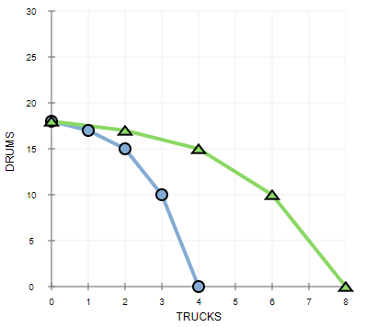
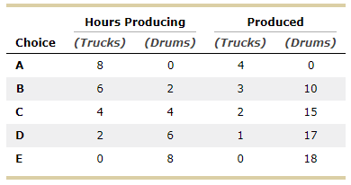
PPF and the opportunity cost
Professor Galvez-Soriano lecture notes. Based on N. Gregory Mankiw, Principles of Microeconomics, 9th Edition.

Slide 2
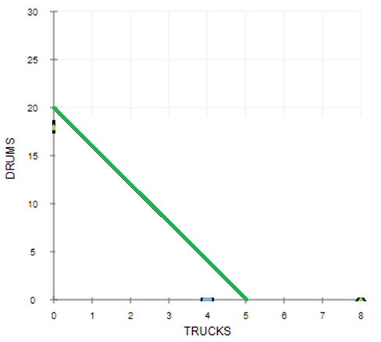
PPF and the opportunity cost
Professor Galvez-Soriano lecture notes. Based on N. Gregory Mankiw, Principles of Microeconomics, 9th Edition.

Slide 3
Chapter 3
Interdependence and the Gains from Trade
Professor Galvez-Soriano lecture notes. Based on N. Gregory Mankiw, Principles of Microeconomics, 9th Edition.

Slide 4
A Parable for the Modern Economy
Only two goods
Meat
Potatoes
Only two people
A cattle rancher named Ruby
A potato farmer named Frank
Both would like to eat both meat and potatoes
Professor Galvez-Soriano lecture notes. Based on N. Gregory Mankiw, Principles of Microeconomics, 9th Edition.

Slide 5
Figure 1 The Production Possibilities Frontier
Empty cell | Minutes needed to make 1 ounce of meat | Minutes needed to make 1 ounce of potatoes | Amount of meat produced in 8 hours | Amount of potatoes produced in 8 hours
Frank the farmer | 60 minutes per ounce | 15 minutes per ounce | 8 ounces | 32 ounces
Ruby the rancher | 20 minutes per ounce | 10 minutes per ounce | 24 ounces | 48 ounces
Professor Galvez-Soriano lecture notes. Based on N. Gregory Mankiw, Principles of Microeconomics, 9th Edition.

Slide 6
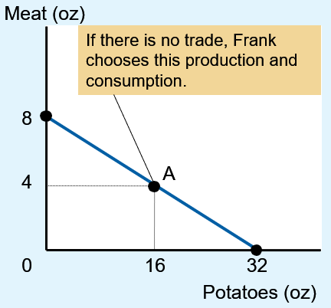
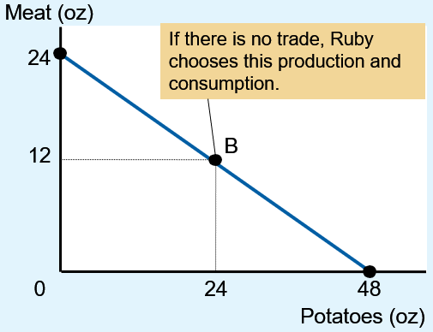
Figure 1 The Production Possibilities Frontier
Frank’s production
possibilities frontier
Ruby’s production
possibilities frontier
Professor Galvez-Soriano lecture notes. Based on N. Gregory Mankiw, Principles of Microeconomics, 9th Edition.

Slide 7
A Parable for the Modern Economy
Specialization and trade
Farmer Frank specializes in growing potatoes
More time growing potatoes
Less time raising cattle
Rancher Ruby specializes in raising cattle
More time raising cattle
Less time growing potatoes
Trade: 5 oz of meat for 15 oz of potatoes
Professor Galvez-Soriano lecture notes. Based on N. Gregory Mankiw, Principles of Microeconomics, 9th Edition.

Slide 8
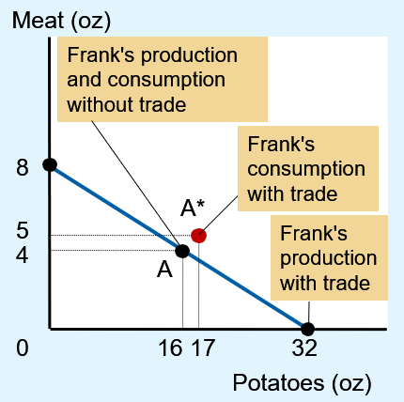
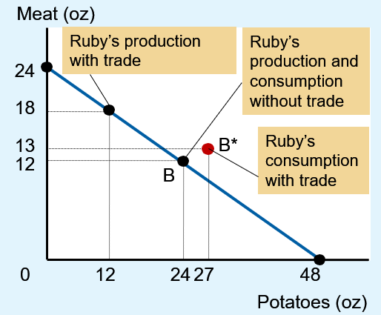
Figure 2 How Trade Expands the Set of Consumption Opportunities
Frank’s production
and consumption
Ruby’s production
and consumption
Professor Galvez-Soriano lecture notes. Based on N. Gregory Mankiw, Principles of Microeconomics, 9th Edition.

Slide 9
Figure 2 How Trade Expands the Set of Consumption Opportunities
Empty cell | Frank’s meat | Frank’s potatoes | Ruby’s meat | Ruby’s potatoes
Production and consumption without trade | 4 ounces | 16 ounces | 12 ounces | 24 ounces
Production with trade | 0 ounce | 32 ounces | 18 ounces | 12 ounces
Trade | Gets 5 ounces | Gives 15 ounces | Gives 5 ounces | Gets 15 ounces
Consumption with trade | 5 ounces | 17 ounces | 13 ounces | 27 ounces
Increase in consumption with gains from trade | Increase of 1 ounce | Increase of 1 ounce | Increase of 1 ounce | Increase of 3 ounces
Professor Galvez-Soriano lecture notes. Based on N. Gregory Mankiw, Principles of Microeconomics, 9th Edition.

Slide 10
Comparative Advantage
Absolute advantage
The ability to produce a good using fewer inputs than another producer
In producing meat: Ruby
Ruby needs 20 min. to produce 1 oz of meat
Frank needs 60 minutes
In producing potatoes: Ruby
Ruby needs 10 min. to produce 1 oz of potatoes
Frank needs 15 minutes
Professor Galvez-Soriano lecture notes. Based on N. Gregory Mankiw, Principles of Microeconomics, 9th Edition.

Slide 11
Comparative Advantage
Opportunity cost
Whatever must be given up to obtain some item
Measures the trade-off between the two goods that each producer faces
Professor Galvez-Soriano lecture notes. Based on N. Gregory Mankiw, Principles of Microeconomics, 9th Edition.

Slide 12
Comparative Advantage
Opportunity cost
Frank: 60 min. to produce 1 oz meat, and 15 min. to produce 1 oz potatoes
To produce 1 more oz meat, give up 4 oz potatoes
To produce 1 more oz potatoes, give up ¼ oz meat
Ruby: 20 min. to produce 1 oz meat, and 10 min. to produce 1 oz potatoes
To produce 1 more oz meat, give up 2 oz potatoes
To produce 1 more oz potatoes, give up ½ oz meat
Professor Galvez-Soriano lecture notes. Based on N. Gregory Mankiw, Principles of Microeconomics, 9th Edition.

Slide 13
Table 1 The Opportunity Cost of Meat and Potatoes
Empty cell | Opportunity cost of 1 ounce of meat | Opportunity cost of 1 ounce of potatoes
Frank the farmer | 4 ounces of potatoes | One-quarter ounce of meat
Ruby the rancher | 2 ounces of potatoes | One-half ounce of meat
Professor Galvez-Soriano lecture notes. Based on N. Gregory Mankiw, Principles of Microeconomics, 9th Edition.

Slide 14
Comparative Advantage
Comparative advantage
The ability to produce a good at a lower opportunity cost than another producer
Reflects the relative opportunity cost
Principle of comparative advantage
Each good should be produced by the individual that has the smaller opportunity cost of producing that good
Specialize according to comparative advantage
Professor Galvez-Soriano lecture notes. Based on N. Gregory Mankiw, Principles of Microeconomics, 9th Edition.

Slide 15
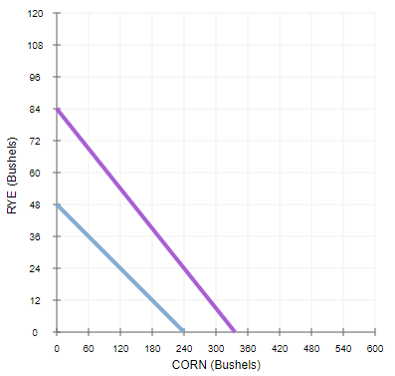
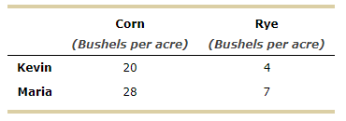
Example: opportunity cost
Each one owns a 12-acre plot of land.
Kevin’s opportunity cost.
Corn:
Rye:
Professor Galvez-Soriano lecture notes. Based on N. Gregory Mankiw, Principles of Microeconomics, 9th Edition.

Slide 16
Example: opportunity cost
Each one owns a 12-acre plot of land.
Maria’s opportunity cost.
Corn:
Rye:
Professor Galvez-Soriano lecture notes. Based on N. Gregory Mankiw, Principles of Microeconomics, 9th Edition.

Slide 17
Example: comparative advantage
Kevin’s opportunity cost.
Corn: 4/20=1/5
Rye: 20/4=5
Maria’s opportunity cost.
Corn: 7/28=1/4
Rye: 28/7=4
Professor Galvez-Soriano lecture notes. Based on N. Gregory Mankiw, Principles of Microeconomics, 9th Edition.

Slide 18
Comparative Advantage
One person
Can have absolute advantage in both goods
Cannot have comparative advantage in both goods
For different opportunity costs
One person has comparative advantage in one good
The other person has comparative advantage in the other good
Professor Galvez-Soriano lecture notes. Based on N. Gregory Mankiw, Principles of Microeconomics, 9th Edition.

Slide 19
Comparative Advantage
Opportunity cost of one good
Inverse of the opportunity cost of the other
Gains from specialization and trade
Based on comparative advantage
Total production in economy rises
Increase in the size of the economic pie
Everyone is better off
Professor Galvez-Soriano lecture notes. Based on N. Gregory Mankiw, Principles of Microeconomics, 9th Edition.

Slide 20
Thursday class
Benefits of trade…
Professor Galvez-Soriano lecture notes. Based on N. Gregory Mankiw, Principles of Microeconomics, 9th Edition.

Slide 21
Comparative Advantage
Trade can benefit everyone in society
People specialize in activities in which they have a comparative advantage
The price of trade
Between the two opportunity costs
The principle of comparative advantage explains:
Interdependence
Gains from trade
Professor Galvez-Soriano lecture notes. Based on N. Gregory Mankiw, Principles of Microeconomics, 9th Edition.

Slide 22
Applications of Comparative Advantage
Should the U.S. trade with other countries?
Imports
Goods produced abroad and sold domestically
Exports
Goods produced domestically and sold abroad
Professor Galvez-Soriano lecture notes. Based on N. Gregory Mankiw, Principles of Microeconomics, 9th Edition.

Slide 23
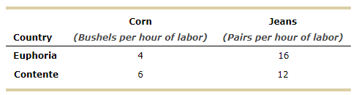
Example: benefits of trade
They each have 4 million labor hours available per week that they can use to produce corn, jeans, or a combination of both.
Contente
Corn: 1M hrs labor => 6M corn
Jeans: 3M hrs labor => 36M jeans
Euphoria
Corn: 3M hrs labor => 12M corn
Jeans: 1M hrs labor => 16M jeans
Professor Galvez-Soriano lecture notes. Based on N. Gregory Mankiw, Principles of Microeconomics, 9th Edition.

Slide 24
Example: benefits of trade
Contente’s opportunity cost
Corn: 12/6 = 2
Jeans: 6/12 = 1/2
Euphoria’s opportunity cost
Corn: 16/4 = 4
Jeans: 4/16 = 1/4
Professor Galvez-Soriano lecture notes. Based on N. Gregory Mankiw, Principles of Microeconomics, 9th Edition.

Slide 25
Example: benefits of trade
Contente’s opportunity cost
Corn: 12/6 = 2
Jeans: 6/12 = 1/2
Euphoria’s opportunity cost
Corn: 16/4 = 4
Jeans: 4/16 = 1/4
Comparative advantage in the production of corn
Comparative advantage in the production of jeans
Professor Galvez-Soriano lecture notes. Based on N. Gregory Mankiw, Principles of Microeconomics, 9th Edition.

Slide 26
Example: benefits of trade
Suppose that each country completely specializes in the production of the good in which it has a comparative advantage, producing only that good.
Contente’s production under specialization:
Corn: 6*4 = 24
Jeans: 12*0 = 0
Euphoria’s production under specialization:
Corn: 4*0 = 0
Jeans: 16*4 = 64
Professor Galvez-Soriano lecture notes. Based on N. Gregory Mankiw, Principles of Microeconomics, 9th Edition.

Slide 27
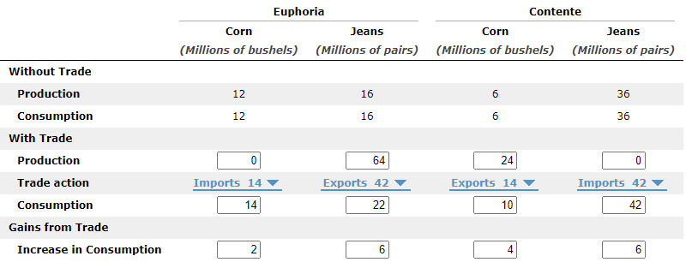
Example: benefits of trade
Suppose the country that produces corn trades 14 million bushels of corn to the other country in exchange for 42 million pairs of jeans.
Countries did not specialize
Corn: 18 million bushels
Jeans: 52 million pairs
Countries did specialize
Corn: 24 million bushels
Jeans: 64 million pairs
Gains
Corn: 6 M
Jeans: 12 M
Professor Galvez-Soriano lecture notes. Based on N. Gregory Mankiw, Principles of Microeconomics, 9th Edition.

Slide 28
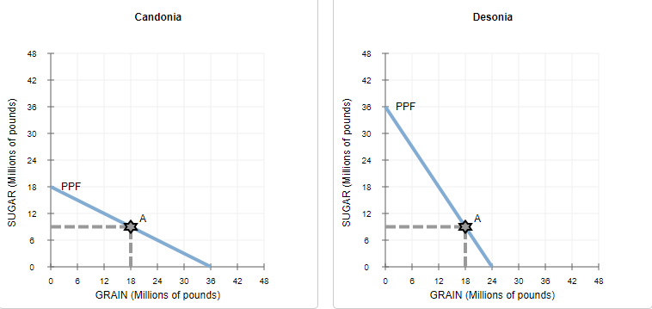
Example: Specialization and trade
9
9
Professor Galvez-Soriano lecture notes. Based on N. Gregory Mankiw, Principles of Microeconomics, 9th Edition.

Slide 29
Example: Specialization and trade
9
9
Candonia’s opportunity cost
Sugar: 36/18 = 2
Grain: 18/36 = 1/2
Desonia’s opportunity cost
Sugar: 24/36 = 2/3
Grain: 36/24 = 3/2
Candonia’s production under specialization:
Sugar : 0
Grain : 36
Desonia’s production under specialization:
Sugar : 36
Grain : 0
Professor Galvez-Soriano lecture notes. Based on N. Gregory Mankiw, Principles of Microeconomics, 9th Edition.

Slide 30
Example: Specialization and trade
9
9
The countries decide to exchange 18 million pounds of grain for 18 million pounds of sugar.
This ratio of goods is known as the price of trade between Candonia and Desonia.
Price of trade = 18/18 = 1 (1/2 > Price of trade > 3/2)
(2/3 > Price of trade > 2/1)
Professor Galvez-Soriano lecture notes. Based on N. Gregory Mankiw, Principles of Microeconomics, 9th Edition.

Slide 31
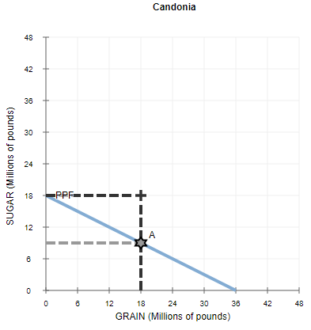
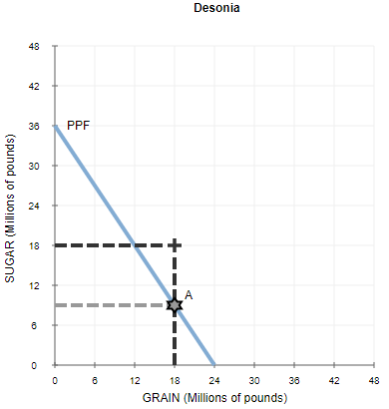
Example: Specialization and trade
Without engaging in international trade, Candonia and Desonia would not have been able to consume at the after-trade consumption bundles.
Professor Galvez-Soriano lecture notes. Based on N. Gregory Mankiw, Principles of Microeconomics, 9th Edition.

